Slide 1

St. Ann’s College Of Engineering And Technology Crime analysis and prediction using optimized k-Means using Machine Learning
Presented By:
K. SAI KALYAN YESWANTH (592)
L. SARVANI SRAVYA (596)
K. SATISH KUMAR (586)
G. SAHANA (562)
Guide:
Mrs. M. LAKSHMI BAI
Associate Professor

Slide 2
CONTENTS
Abstract
Introduction
Objectives
Scope of the project
Existing system
Proposed system
System requirements
Data Collection
Methodologies
Modules
Design(UML Diagrams)
References

Slide 3
ABSTRACT
Crime analysis is methodological approach for identify the crime areas. The crime areas are mainly based on the crime type these identified crime areas are helpful to reduce the crime rate.
This can be very easy to identify the crime areas, based on this process the crime rate can be analyzed.
With the increasing of computer systems the crime data analysts can help to the crime investigators to analyze the crime. Based on the clustering and preprocessing extract the crime areas from a structured data.
The cause of occurrences of crimes like crime details of person and other factors we are focusing mainly on crime factors of previous years.
The need of crime analysis to identify the crime areas and type of crime is ongoing, timely manner, to utilize the crime investigators and it can be proactive for analyzing and rectifying the crime rate. Analyze crime to meet the law enforcement needs of a changing society analyze crime to understand the criminal behaviors.

Slide 4
INTRODUCTION
Crime data are categorized using the crime type, It can be useful to identify the crime areas based on the crime category and very useful to protect the crime areas to decrease the crime rate. Crimes are influenced by organizations and other places occurred frequently in a society.
The main use of analyze the crime areas is to identify the crime areas after analyze the clusters, crime occurrences frequently during different years. Crime prediction is used to identify the crime occurred areas and reduce those crimes, this can be very useful to decrease the crime rate.
Based on the structured data analyze the crimes. Crime analysis is an approach it can be very useful to identify the crime areas based on the historical crime data the crime areas are will be identified. In this process analyze the crime problems in all types of categories, state wide the crime patterns are defined based on the geographical terms.

Slide 5
CONT..
The use of crime prediction is to analyzing and decreasing the future crime. Using the old data crime locations are identified. The Data mining prediction techniques are useful to enhance the accuracy, performance, speed of predicting the crime. Using the mining techniques crime patterns are analyzed based on the current and old data .
In clustering, the data items are clustered according to their logical relationships or natural groupings and a structure as a whole is generated. There are no predefined groups. Each cluster is collection of homogeneous elements. Crime Prediction Techniques provide an accurate prediction for the location of the crime. Collecting and managing large volumes of accurate data.

Slide 6

OBJECTIVE OF THE PROJECT
The main objective of the project is to analyze the crime patterns and identify the crime predicted areas based on the crime rate using the crime data. Using the fuzzy clustering obtain the crime patterns to know in which area the crime will occur frequently.

Slide 7
SCOPE OF THE PROJECT
It predicts the crime an individual criminal is likely to commit, and also predict the estimated time for the crime to take place as a future scope.
Along with this, one can try to predict the location of the crime.

Slide 8
EXISTING SYSTEM
The detection of the crime types and patterns are used to identify and analyse the crime, this process is used to provide the information to reduce the crime rate and identify the common crime rates.
The further occurrences of similar incidence the crime analysis is mainly focused on the crime regions in this process the crime data is used based on the crime data the crime areas are identified, mainly concentrate on crimes such as kidnapping, murder, Theft, Robber etc.

Slide 9
PROPOSED SYSTEM
In the crime analysis process in the step one crime data will be loaded then the noisy data will be removed based on the pre processing phase.
Cluster the data using the clustering technique, the fuzzy k-means is a clustering algorithm is used to cluster the data then identify the crime patterns based on the crime data finally the visualize the crime prone areas.
The system mainly contain four modules
Pre-processing the crime data
Clustering Crime data
Pattern Identification of crime data
Predicting the crime areas

Slide 10
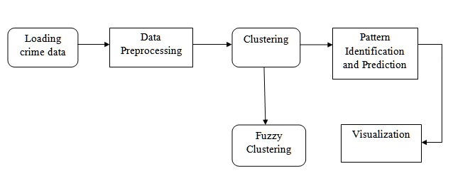
BLOCK DIAGRAM
Fig. 1 Crime analysis steps

Slide 11
SYSTEM REQUIREMENTS
Hardware:-
RAM – 4GB
Software:-
Python IDLE
OS – Windows 7,8 or 10 (32 or 64 bit)
Anaconda
Jupiter notebook

Slide 12
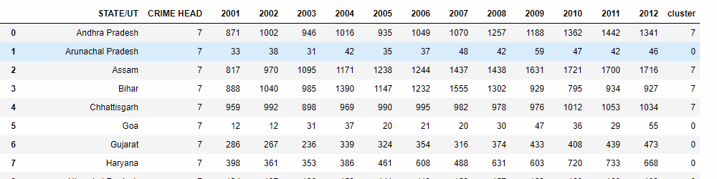
DATA COLLECTION
Data Collection website:- https://www.kaggle.com/datasets

Slide 13
METHODOLOGIES
Database Collection of .csv files
Modules Collection
Training And Testing Methodology
Prediction Of Trained Data

Slide 14
MODULES
The system mainly contain four modules
Pre-processing the crime data
Clustering Crime data
Pattern Identification of crime data
Predicting the crime areas

Slide 15
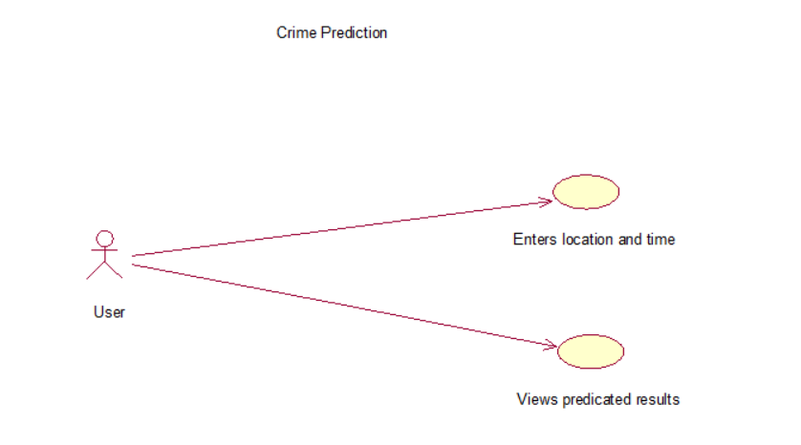
Use Case Diagram

Slide 16
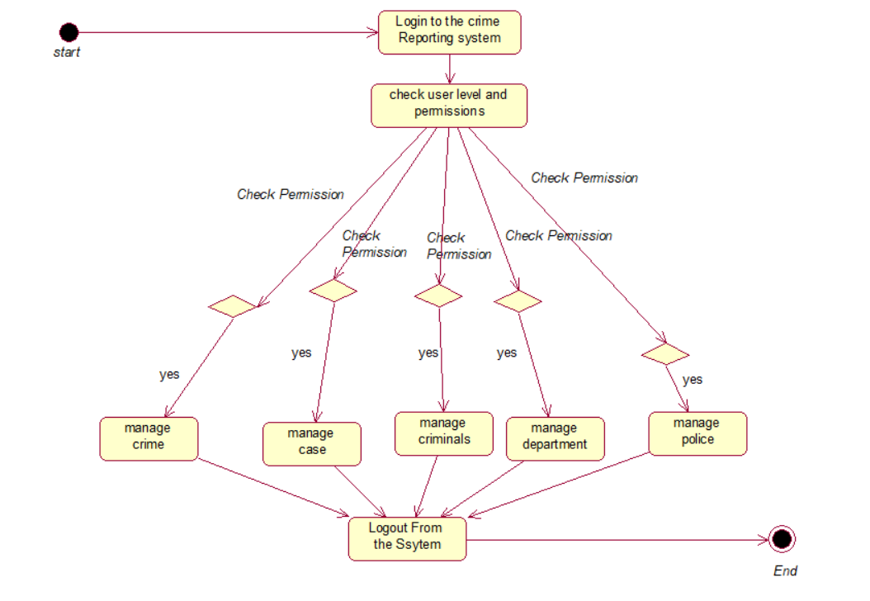
Activity Diagram

Slide 17
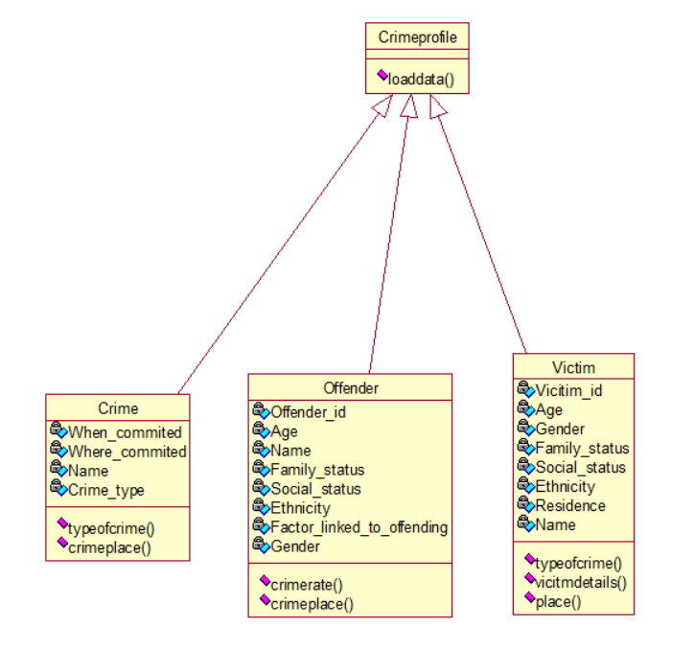
Class Diagram

Slide 18
REFERENCES
Aishwarya DS,Madhumalathi S,Manisha UA, Sushma K M, Ravikumar V G “Prediction of Crime Pattern and Suspects Using Data mining Techniques”, 3rd National Conference on Image Processing, Computing, Communication, Networking and Data Analytics, June 2018.
Chhaya Chauhan, SmritiSehgal “Crime Analysis Using Data Mining Techniques and Algorithms”, International Conference on Computing, Communication and Automation (ICCCA), IEEE, May2017.
Suil Yadav, Meet Timbadia, Ajit Yadav, Rohit Vishwakarma and Nikhilesh Yadav,“Crime Pattern Detection, Analysis & Prediction”, International Conference on Electronics, Communication and Aerospace Technology (ICECA), pp225-230, IEEE, 2017.
Malathi. A, Dr. S. Santhosh Baboo, “An Enhanced Algorithm to Predict a Future Crime using Data Mining” International Journal of Computer Applications (0975 – 8887) Vol. 21–, No.1, May 2011.
J. Agarwal, R. Nagpal, and R. Sehgal, “Crime analysis using k-means Clustering”, International Journal of Computer Applications, Vol. 83 , No4, December 2013.

Slide 19
ANY QUERIES..?

Slide 20
THANK YOU

